Slide 1
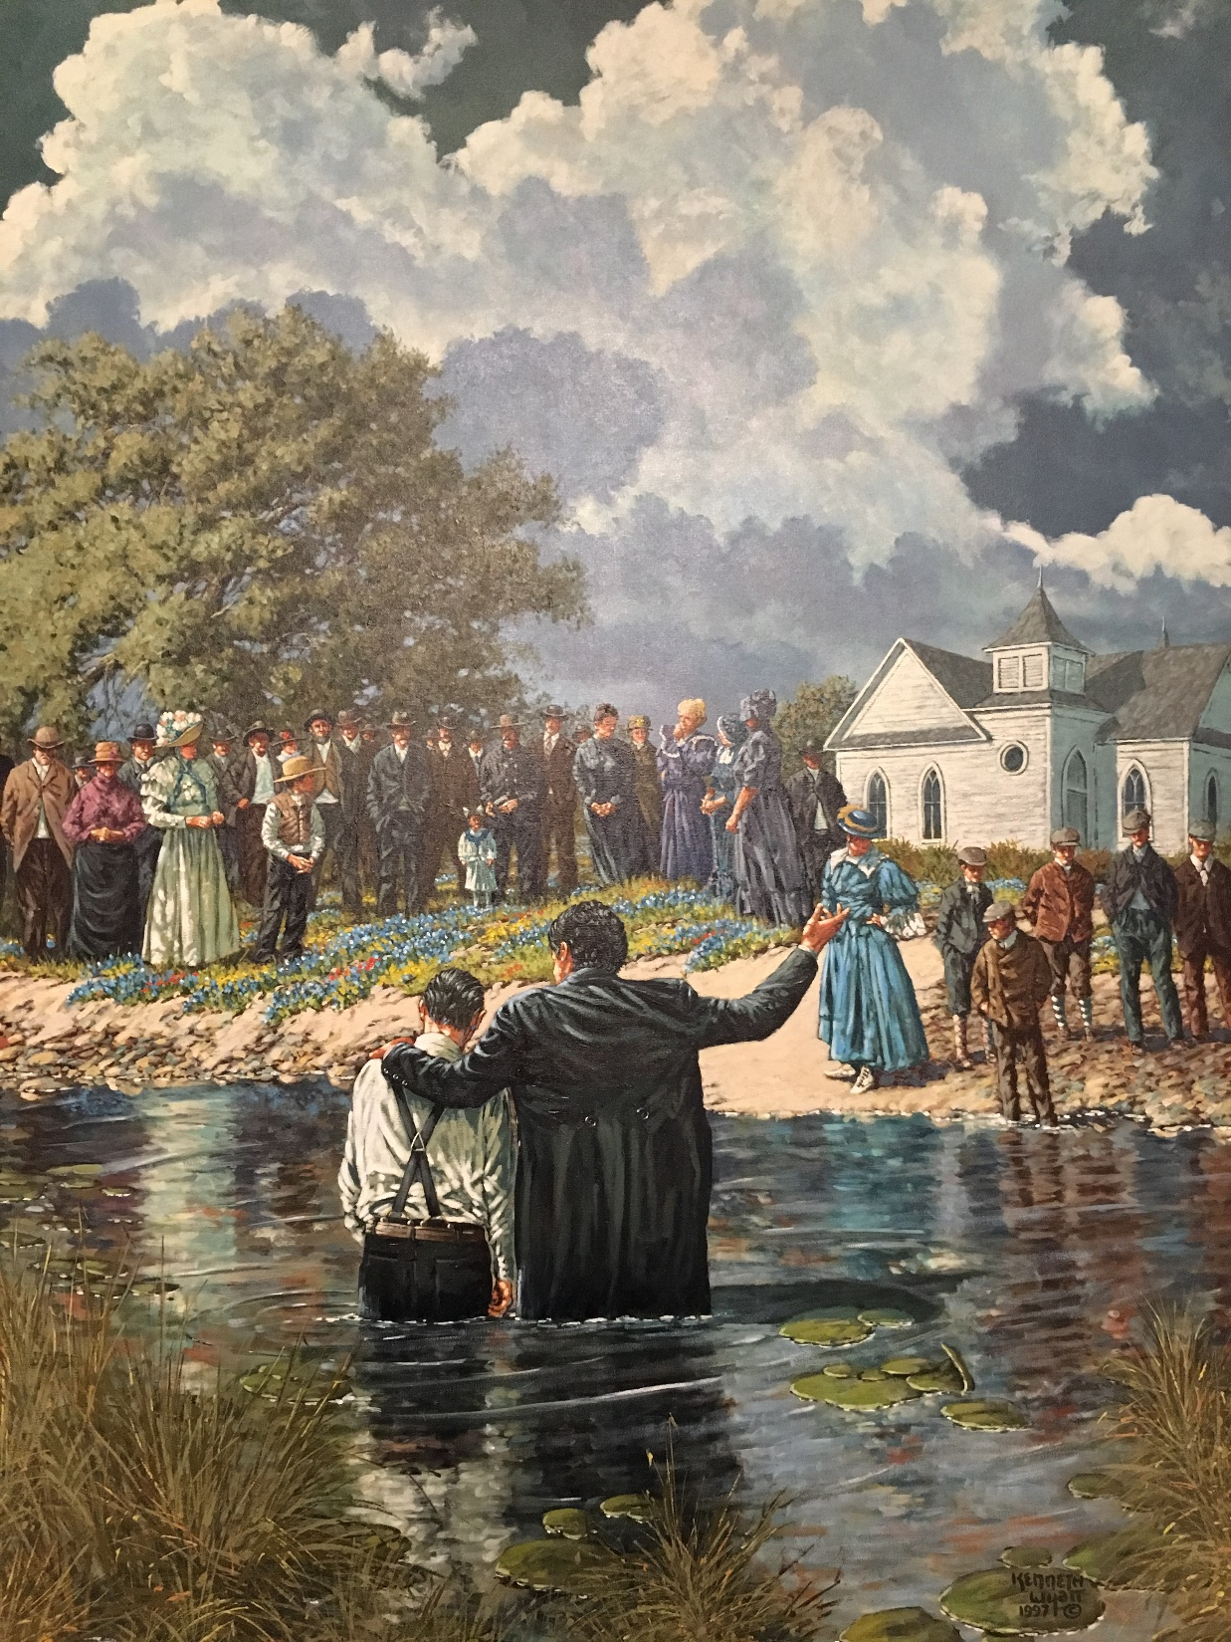
Still a Baptist
Month day, year
…neither angry nor ashamed of it
Seminar
Hope Baptist Church
Fairfield OH
March 1, 2020

Slide 2

Still a Baptist
…neither angry nor ashamed of it
The Beginning of New Testament Churches
Matthew 16:16-18

Slide 3
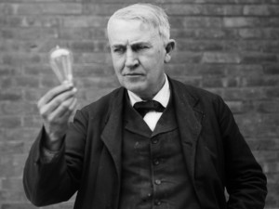
Still a Baptist
…neither angry nor ashamed of it
The first light bulb
Thomas Edison
1879

Slide 4
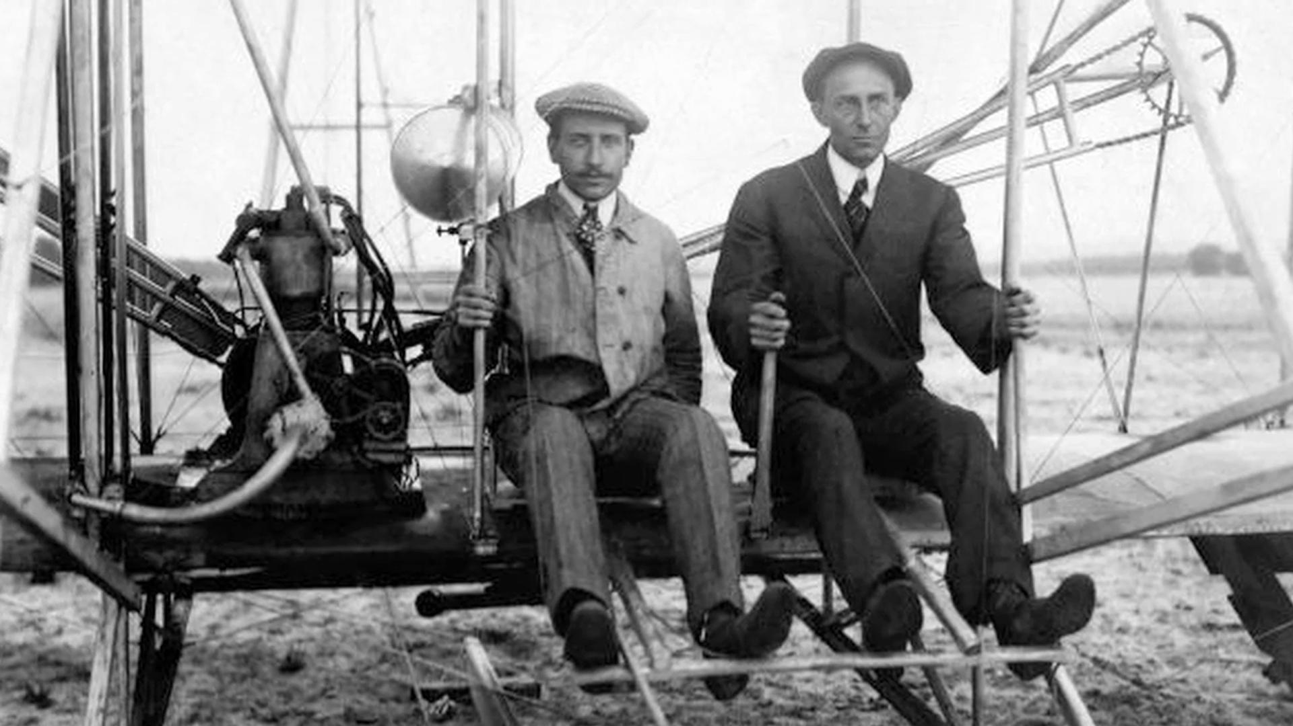
Still a Baptist
…neither angry nor ashamed of it
The first: airplane
Orville & Wilbur Wright
1903

Slide 5
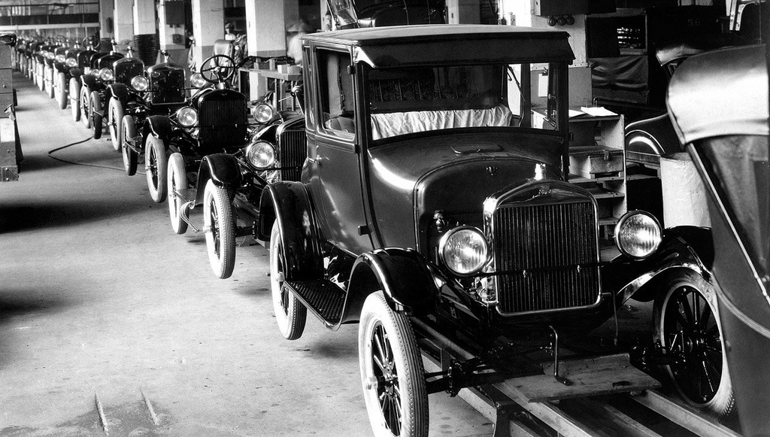
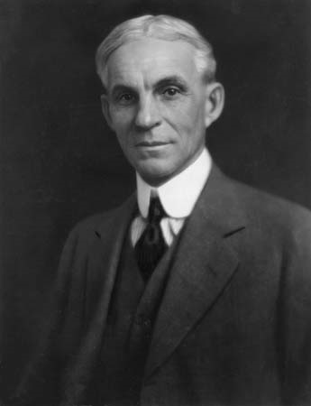
Still a Baptist
…neither angry nor ashamed of it
The first Assembly-line Vehicle - Henry Ford
1913

Slide 6
Still a Baptist
…neither angry nor ashamed of it
The first Church -
Jesus Christ

Slide 7
Still a Baptist
…neither angry nor ashamed of it
Matthew 16:18
“I” = Person, Jesus Christ
“will” = promise
“build” = process

Slide 8
Still a Baptist
…neither angry nor ashamed of it
Matthew 16:18
“my” = possession
“church” = purpose
“the gates of hell” = prevailing power

Slide 9
Still a Baptist
…neither angry nor ashamed of it
Matthew 16:18
“shall not prevail against it” = perpetuity

Slide 10
Still a Baptist
…neither angry nor ashamed of it
The Origin of the New Testament church is
DIVINE, not HUMAN

Slide 11
Still a Baptist
…neither angry nor ashamed of it
The church is not an
OLD TESTAMENT
Institution but a
NEW TESTAMENT
Institution

Slide 12
Still a Baptist
…neither angry nor ashamed of it
The church was founded by
JESUS CHRIST during His earthly ministry

Slide 13
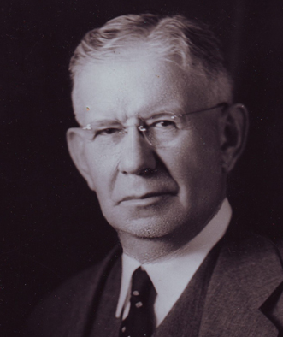
Still a Baptist
L. R. Scarborough (1870-1945)
President of SWBTS and the SBC Convention
…neither angry nor ashamed of it
“It is certainly true that Christ in His own personal ministry established His church.”

Slide 14
Still a Baptist
…neither angry nor ashamed of it
“Out of the material prepared by John the Baptist, Jesus organized and founded His church during the days of His personal ministry here on the earth.”
Roy Mason (1894-1978)

Slide 15
Still a Baptist
…neither angry nor ashamed of it
The church was NOT founded on the DAY OF PENTECOST by the Holy Spirit

Slide 16
Still a Baptist
…neither angry nor ashamed of it
The Day of Pentecost
was not the FORMATION
of the church, but the
CONFIRMATION
of the Church Jesus established

Slide 17
Still a Baptist
…neither angry nor ashamed of it
God the Father Envisioned the church
God the Son Equipped the church
God the Spirit Empowered the church

Slide 18
Still a Baptist
…neither angry nor ashamed of it
The Nature of the New Testament church is
LOCAL & VISIBLE,
not
UNIVERSAL & INVISIBLE

Slide 19
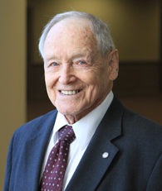
Still a Baptist
Dr Gray Allison
(1924-2019)
Founder &
President Emeritus
Mid-America Baptist Theological Seminary
…neither angry nor ashamed of it
“The ecclesia is a local church. This is what Christ meant when He used the word. Would the apostles have been able to understand any other meaning? What other kind can minister the Word to lost persons as well as minister to the physical needs of poor people and those who are ill? What other kind can preach the Gospel?”

Slide 20
Still a Baptist
…neither angry nor ashamed of it
“Local Church”

Slide 21
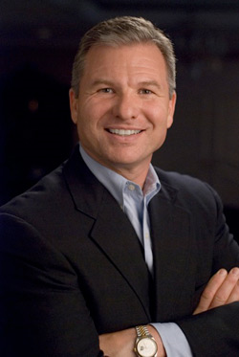
Still a Baptist
Bob Pearle (1953- )
Birchman Baptist Church
Ft Worth TX
…neither angry nor ashamed of it
“Why all the debate about the distinction between the universal and local church? Why spend so much time on the etymology of “ekklesia” and its uses in the New Testament? The reason is simple. Misunderstand-ing the New Testament concept of the church diminishes the importance of the local church to the individual believer.

Slide 22
Still a Baptist
Bob Pearle (1953- )
Birchman Baptist Church
Ft Worth TX
…neither angry nor ashamed of it
When the local church is trumped by the universal church, personal account-ability is minimized, Christian growth is stunted, and practically, the local church vanishes. People move from church to church to ‘bless’ each congregation with their ‘gifts’ and insights only to become spiritual pygmies. The work of God in this world is done primarily through the local congregations. That is God’s plan.”

Slide 23
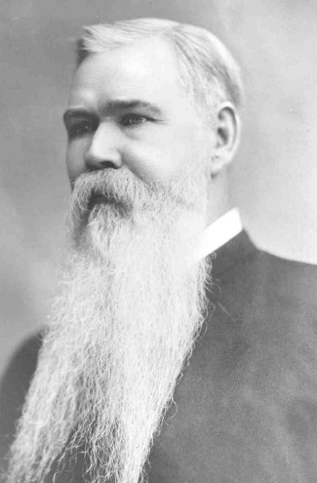
Still a Baptist
B. H. Carroll (1843-1914)
Founding President of SWBTS
…neither angry nor ashamed of it
“The whole of the modern Baptist idea of a now existent ‘universal, invisible church’ was borrowed from Pedo-baptist (those who advocate or practice infant sprinkling, jdl) confessions of faith in the Reformation times, and the Pedo-baptists devised it to offset the equally erroneous idea of the Romanist ‘universal visible church’. We need to be well indoctrinated on this point, because the error is not harmless. It is used to depreciate Christ’s earth-church, the pillar and ground of the truth.”

Slide 24
The Scriptural Church The Invisible Church
1. Visible, definite, 1. Invisible, indefinite
localized
2. Organized 2. No organization
3. Officers 3. No officers
4. Unity 4. Schism
5. Functional 5. Not functional
6. Commissioned 6. Not commissioned
7. Ordinances 7. No ordinances
8. Discipline 8. No discipline
9. Pillar and ground 9. Every wind of doctrine
of the truth
10. Is an assembly 10. Has never assembled
11. Cares for and 11. Saints drift without
edifies saints direction
12. Maintains sound 12. No doctrine - promotes doctrine ecumenicalism

Slide 25
Still a Baptist
…neither angry nor ashamed of it
1833 New Hampshire Confession of Faith S No universal church
1925 Baptist Faith and Message
S No universal church

Slide 26
Still a Baptist
…neither angry nor ashamed of it
1963 Southern Baptist Confession of Faith
Added…“the church is the body of Christ which includes all the redeemed of all the ages.”
2000 Baptist Faith and Message
Declared…“The New Testament speaks also of the Church as the Body of Christ which includes all the Redeemed of all the ages, believers from every tribe, and tongue, and people, and nations.”

Slide 27
Still a Baptist
…neither angry nor ashamed of it
Advantages of the “Local ecclesia (assembly) Only” position…
1. It advances the clear meaning of the word “ecclesia.”

Slide 28
Still a Baptist
…neither angry nor ashamed of it
2. It reinforces the compelling need for church membership.
3. It exposes the dangers of inter-denominationalism & ecumenicalism.

Slide 29
Still a Baptist
…neither angry nor ashamed of it
4. It underscores the church’s complete autonomy & dependence on Christ.
5. It places the need to maintain doctrinal purity on each congregation.

Slide 30
Still a Baptist
…neither angry nor ashamed of it
The Root & Fruit of the New Testament church is
HISTORICAL
not
MODERN

Slide 31
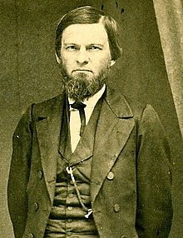
Still a Baptist
John A. Broadus
(1827-1897)
President of Southern Baptist Theological Seminary
…neither angry nor ashamed of it
Speaking of death…“All earthly things go down through these dread gates, but Christ’s church, for which he gave himself, will never cease to exist; there will always be Christians in the world. This was a bold prediction for a homeless teacher, with a handful of followers.”

Slide 32
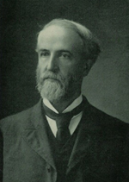
Still a Baptist
T.T. Eaton
(1845-1907)
Baptist Pastor, Author, University Professor
…neither angry nor ashamed of it
“Those who oppose Baptist succession have no logical ground to stand on in organizing a church out of material furnished by other churches, and with those regularly baptized by regular ordained ministers.”

Slide 33
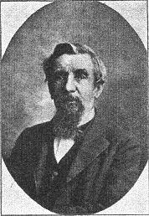
Still a Baptist
S.H. Ford
(1819-1905)
Baptist Historian
…neither angry nor ashamed of it
“Succession among Baptists is not a linked chain of churches or ministers, uninterrupted and traceable at this distant day… The true and defensible doctrine is that baptized believers have existed in every age since John baptized in Jordan, and have met as a baptized congregation in covenant and fellowship where an opportunity permitted.”

Slide 34
Still a Baptist
L. R. Scarborough (1870-1945)
President of SWBTS and the SBC Convention
…neither angry nor ashamed of it
“Without boast or pride but with joy and certainty, Baptists trace their lineage back to an ancient and honorable beginning – to the meeting of John the forerunner and Jesus in the holy baptizing scene in the Jordan River. Through the centuries, sometimes by indistinct lines, sometimes by definite groups and mighty doctrines, they profess love for and loyalty to teachings and principles which Christ gave to the apostolic group and are recorded in the New Testament.” 1939 SBC Presidential Address

Slide 35
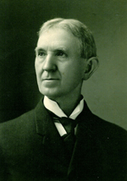
Still a Baptist
William H Whitsett
(1841-1911)
President of Southern Baptist Theological Seminary
…neither angry nor ashamed of it
Modern View – Baptists began in 1644 when the name “Baptist” appeared
In a 1893 article in Johnson’s Universal Encyclopedia Whitsett argued that the practice of immersion began in seventeenth century England.

Slide 36
Still a Baptist
William H Whitsett
(1841-1911)
President of Southern Baptist Theological Seminary
…neither angry nor ashamed of it
He taught that up to 1641 all Baptists employed sprinkling and pouring as the mode of baptism and that no case of immersion took place among American Baptists before the year 1644.

Slide 37
Still a Baptist
D.B. Ray
(1830-1922)
Baptist Author &
Apologist
…neither angry nor ashamed of it
“No man now living will see the end of the hurt Dr. Whitsett has done the Baptists, no matter how often his position is disproved.”

Slide 38
Still a Baptist
…neither angry nor ashamed of it
The Importance of the New Testament church is
ESSENTIAL
not
OPTIONAL

Slide 39
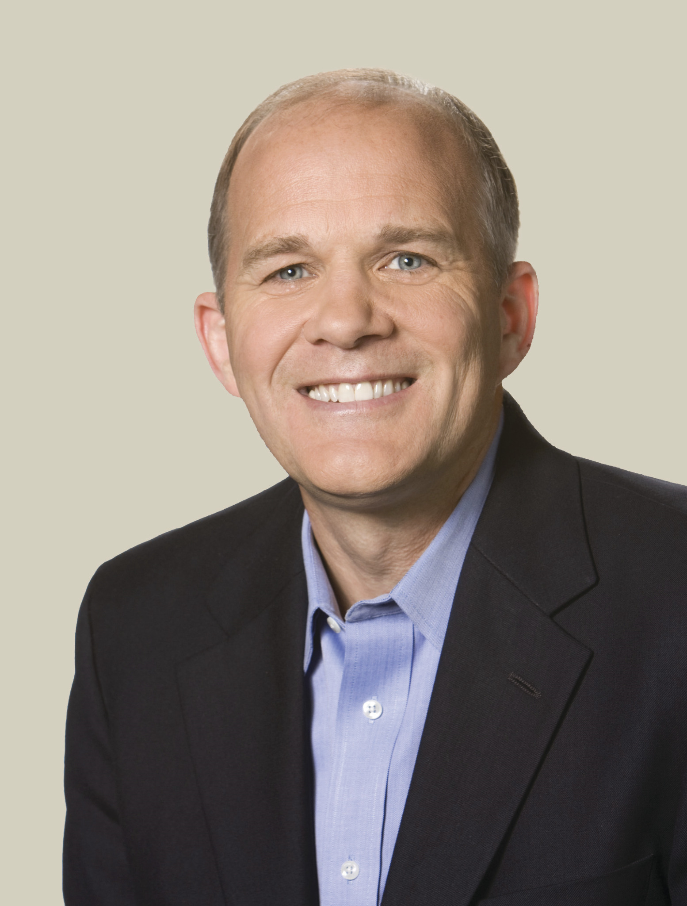
Still a Baptist
Gary Thomas (1961- )
Author
Authentic Faith
…neither angry nor ashamed of it
“This may sound shocking to some, but biblically, living for God means living for his church.”

Slide 40
Still a Baptist
…neither angry nor ashamed of it
In the New Testament…
…if you assembled with believers, it was with a church assembly.

Slide 41
Still a Baptist
…neither angry nor ashamed of it
In the New Testament…
…if you had Christian fellowship, it was church fellowship.

Slide 42
Still a Baptist
…neither angry nor ashamed of it
In the New Testament…
…if you had prayer with other believers, it was a church prayer meeting assembly.

Slide 43
Still a Baptist
…neither angry nor ashamed of it
In the New Testament…
…if you had a Bible study with other believers, it was a church Bible study.

Slide 44
Still a Baptist
…neither angry nor ashamed of it
In the New Testament…
…if you were involved in Christian ministry, it was a church ministry.

Slide 45
Still a Baptist
…neither angry nor ashamed of it
In the New Testament…
…if you had a spiritual gift, it was exercised as a church gift.

Slide 46
Still a Baptist
…neither angry nor ashamed of it
In the New Testament…
…if you operated with spiritual authority, it was with church authority.

Slide 47
Still a Baptist
…neither angry nor ashamed of it
In the New Testament…
…if you gave financially to God’s work, it was money given to and for the work of the church.

Slide 48
Still a Baptist
…neither angry nor ashamed of it
In the New Testament…
…if you were doing God’s work you were doing church work.

Slide 49
Still a Baptist
…neither angry nor ashamed of it
In the New Testament…
…if you were doing missionary work, you were doing missionary out of a church.

Slide 50
Still a Baptist
…neither angry nor ashamed of it
Those who hold to historic Baptist beliefs must prize them, preach them, practice them, protect them, preserve them, and propagate them…and don’t be angry or ashamed of it!

Slide 51
Still a Baptist
…neither angry nor ashamed of it
Christ-centered
and
Church-Connected

Slide 52
Still a Baptist
Month day, year
…neither angry nor ashamed of it

